Slide 1
Nevada Ryan White Eligibility 101
PRESENTERS:
Part A: Jose Alcazar, Tony Garcia
Part B: Gabriel Colbaugh

Slide 3
Learning Objectives
Identify specific eligibility requirements for Nevada Ryan White Universal Eligibility.
Identify acceptable forms and verifications of identification, proof of diagnosis, proof of residency, and proof of income level.
Review components for Ryan White health and dental insurance process.

Slide 4
Ryan White Eligibility
To be eligible for Ryan White services a client must meet the following requirements:
Have a Positive HIV Diagnosis
Household income under 400% of the Federal Poverty Level (FPL).
Be a resident of the State of Nevada (for Part A services clients must reside within the TGA).
Per program guidance from HRSA, undocumented individuals that test positive for HIV are eligible for care under the Ryan White Program. including NMAP, regardless of immigration status.

Slide 5
Who May Apply For Ryan White Services
The following persons may apply for services:
Any individual seeking services.
The individual’s legal guardian.
A person designated in the individual’s medical power of attorney (i.e., their court-appointed representative or legal representative). Proper documentation must be collected at initial determination and re-determination to verify guardianship or medical power of attorney.
NOTE: Minors Seeking Services: Minors (under 18 years old) may receive services. Those seeking services without parental consent will be determined on a case-by-case basis with the approval of Ryan White Program Administrators.

Slide 6
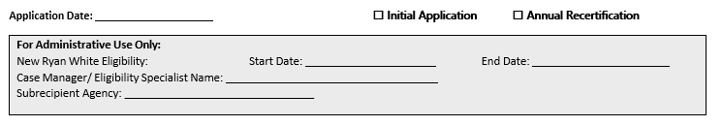
APPLICATION, START & END DATE
Application Date: Date the complete application was received by the processing agency.
Initial Application: Check if individual is a new client, or a client who is returning to care.
Annual Recertification: Check here for client’s who are recertifying their status.
Start Date:
The Eligibility Start Date will always be the date the client has completed the eligibility packet.
End Date:
The Eligibility End Date will always be the last day of the month.
Eligibility Start and End dates are determined by the actual birth month of the client.

Slide 7
Mailed Applications
Mailed and/or emailed applications are acceptable with verbal verification from the client.
In this case the Eligibility start date will be from the date the application & documentation was received/dated and reviewed for completeness by the eligibility Subrecipient.
Eligibility packets should be reviewed within 24 hours after they are received by the Subrecipient, so the client’s eligibility is not unnecessarily delayed

Slide 8
GAP CERTIFICATION & ALIGNMENT BREAK DOWN
Gap Certification and Alignment are the months a consumer is eligible prior to their birthday / half birthday cycle of registration.
In order to align a client to birthday/half-birthday eligibility dates eligibility specialist must:
Identify the client’s birthday month and half birthday month.
Identify the client’s enrollment start date (application fully completed date).
Eligibility end date will always be the birthday / half birthday month (following the rule of never one (1) month of eligibility or more than seven (7) months of eligibility).

Slide 9
GAP CERTIFICATION & ALIGNMENT
EXAMPLES
Client A
Initial eligibility Date: 4/12/2022
Birthday: 7/15/1999
Half Birthday month – January
Client B
Initial eligibility Date: 1/12/2022
Birthday: 12/22/2000
Half Birthday month – June
Client C
Initial Eligibility Date: 3/2/2022
Birthday: 4/28/1958
Half Birthday month: ???
Client D
Initial eligibility Date: 9/21/2022
Birthday: 5/03/1982
Half Birthday month: ???
Client A
4/12/2022 Initial certification
7/2022 Birthday month Annual certification
1/2023 Half birthday month Recertification
Client B
1/12/2022 Initial certification
6/2022 Half birthday month recertification
12/2022 Birthday month annual certification
Client C
??? Initial Annual certification
??? Recert or Annual certification
??? Recert or Annual certification
Client D
??? Initial Annual certification
??? Recert or Annual certification
??? Recert or Annual certification

Slide 10
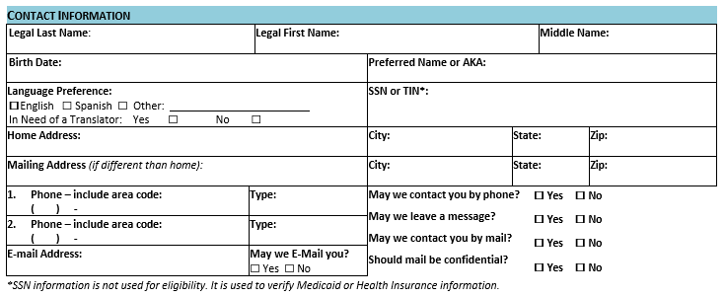
CONTACT INFORMATION
If client has any special instructions for being contacted, please make note on the application and in their case notes in CAREWare.
SSN or TIN: are optional not required.

Slide 11
Emergency Shelters & Trafficking Victims
Contact their shelter case manager to review the policy of the shelter.
Use client’s P.O. Box for mailing address (if they have one); or
Write “confidential address” on the physical address section of the application and also in CAREWare/RWISE Demographics tab.
In the Residency section check the Verification of Residence Form or attach a verification letter from the shelter representative

Slide 12
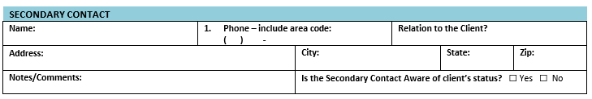
Secondary Contact
A secondary contact is an individual a client has identified for their case manager to contact when they are unable to reach the client, or in case of some related emergency.
A secondary contact doesn't have to be a close relative or friend. It can be literally anybody.
Clients do not need to have a secondary contact, this is optional.
This information is a confidential personal record and is only provided to others on a need-to-know basis.
If the secondary contact does not know the client's status, it is up to the case manager to keep said status confidential when communicating with the client’s emergency contact.

Slide 13
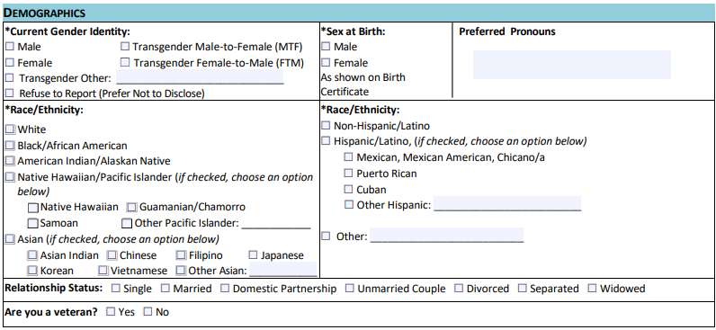
DEMOGRAPHICS
Demographic information allows us to better understand certain background characteristics of our clients. This information helps the Ryan White Program communicate effectively with our service community, as well as understand our client(s) varied cultures, which may affect their health.

Slide 14
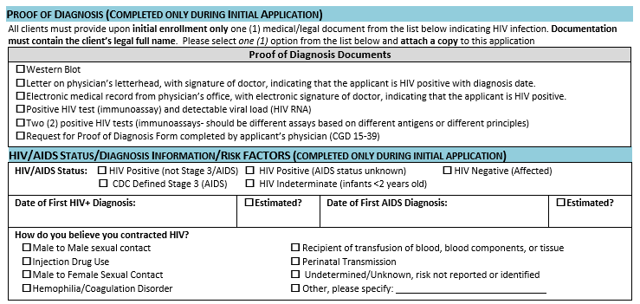
HIV Status and Proof Diagnosis Information
An applicant is required to have documentation of a medical diagnosis of HIV from a laboratory test confirming the client’s HIV infection for their initial determination of eligibility.
Documentation of HIV-positive status must be reviewed and confirmed before initial enrollment by a case manager.

Slide 15
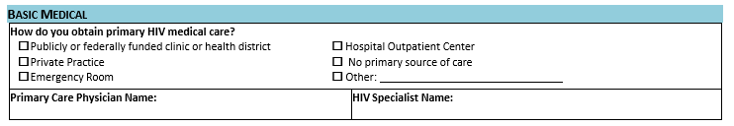
BASIC MEDICAL

Slide 16
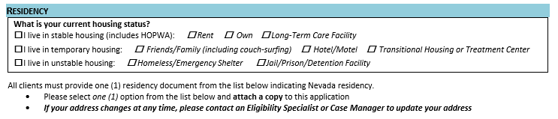
RESIDENCY
For eligibility, residency refers to clients who make Nevada their home. A specific number of weeks or months in Nevada are not required to be considered as a resident in Nevada; however, a client’s intent to remain in Nevada is of interest, particularly for medical and treatment services
Part A TGA residency is limited to Clark County (NV), NYE County (NV) and Mohave County (AZ)
If the client is to be incarcerated for a time period greater than 3 months, they are not Ryan White eligible, please refer the client to the Department of Corrections for further assistance.

Slide 17
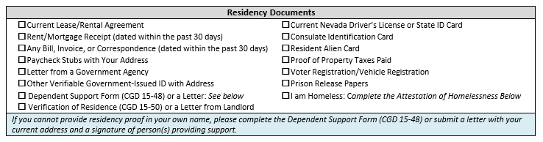
RESIDENCY
DOCUMENTATION
All clients must provide one (1) residency document from the list below indicating Nevada residency.

Slide 18
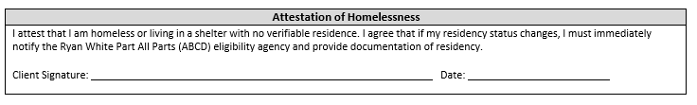
ATTESTATION OF HOMELESSNESS
If client states that she/he is homeless or lying-in a shelter with no verifiable residence, please have them complete the Attestation of Homelessness in the initial and/or annual recertification application.
Homeless is defined as:
An individual or family with a primary nighttime residence that is a public or private place not designed for or ordinarily used as a regular sleeping accommodation for human beings, including a car, park, abandoned building, bus or train station, airport, or camping ground.
An individual or family living in a supervised publicly or privately operated shelter designated to provide temporary living arrangements (including congregate shelters, transitional housing, and hotels and motels paid for by charitable organizations or by federal, State, or local government programs for low-income individuals).
An individual or family who is fleeing, or is attempting to flee, domestic violence, dating violence, sexual assault, stalking, or other dangerous or life-threatening conditions that relate to violence against the individual or a family member, including a child, that has either taken place within the individual's or family's primary nighttime residence or has made the individual or family afraid to return to their primary nighttime residence.
An individual or family who has no other residence; and/or lacks the resources or support networks, e.g., family, friends, and faith-based or other social networks, to obtain other permanent housing.

Slide 19

INCOME
The Nevada Ryan White Program(s) uses MAGI to calculate client taxable income.
The calculated income is used to identify the client’s Federal Poverty Level (FPL).

Slide 20
INCOME
For Nevada, eligibility is for those who have a household income that is at, or below 400% of the Federal Poverty Level (FPL).
Proof of income must be provided for the client and each adult member of his or her household and reviewed by a Case Manager prior to initial enrollment.
Gross income is the amount used when determining eligibility (except where the client reports he/she is self-employed).
For eligibility determination household income includes the client’s income and all income of anyone the client claims on their taxes or the income of someone who claims the client as a dependent on their taxes.
Income is determined by the best estimate of earned income and any unearned income received regularly.

Slide 21
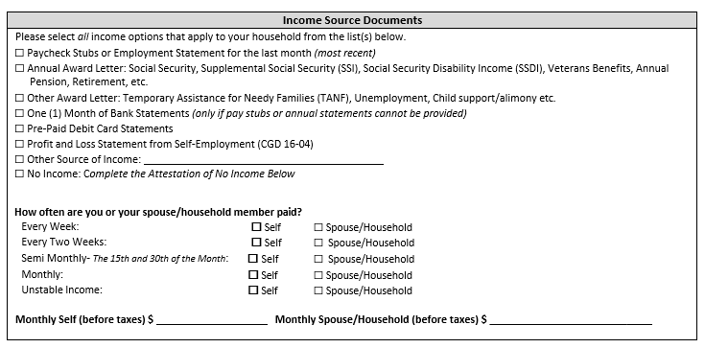
INCOME SOURCE DOCUMENTS
Proof of income must be provided for the client and each contributing member of their Assistance Unit (including spouse and tax dependents).
Any income source documentation provided must include the applicant’s name.

Slide 22
Income Sources
Employment Income
For individuals with regular, non-seasonal employment, documentation must be the most current possible (within a 30-day period). The most recent documentation can be no more than 30 days older than the date that the application was signed by the client.
2 Paystubs for Semi-Monthly, 2 Paystubs for Bi-Weekly, 4 Paystubs for Weekly
For clients employed seasonally by the same employer, documentation should be a current pay stub that shows the year-to-date earnings.
Employment income includes any overtime pay, tips, bonuses and commissions. All must be reported.
Persons who have multiple employers and/or job positions over the course of the year make it difficult to calculate annual income. In these cases, income documentation may be supported by providing the most recently filed Federal Tax Return.
Spousal Income
Spousal income must be reported and documented for any client who is reported as married. This must be included on the client’s application and the documentation requirements are the same as those for the client.

Slide 23
Other Considerations
Married Couples
In the case of married couple living together, each spouse is included in the assistance unit of the other spouse regardless of whether they expect to file joint tax return.
Domestic Couples (NRS 122A.100)
Domestic partners will be treated as spouses in Nevada for determining eligibility.
May be considered a step-parent to their partner’s minor children
Children adopted by both partners may be claimed as a dependent by either partner but cannot be claimed by both.
Accept client statement for verification of household composition.
Divorced Couples (IRS 501)
If a couple is divorced under a final decree by the last day of the year, they are considered unmarried for the whole year.

Slide 24
Taxable Income
Income that is not earned from employment but must also be documented to determine eligibility.
Examples: Renal Income, Business/Self-Employment, SSDI, and Unemployment Benefits (this does not include payments from federal COVID dollars)

Slide 25
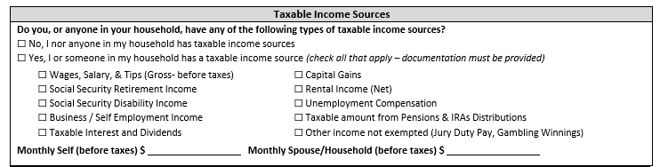
Taxable Income
Income that is not earned from employment but must also be documented to determine eligibility.

Slide 26
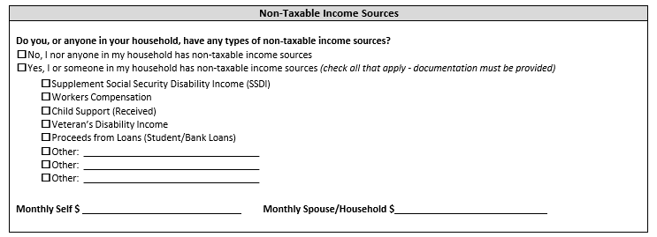
Non-Taxable Income
Non-Taxable Income is all income that is not earned from employment. It includes benefits from other programs and must be documented to determine eligibility.

Slide 27
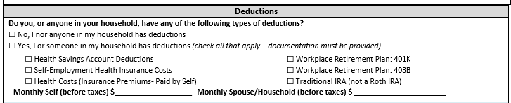
Deductions
Currently monthly budgeting only allows pre-tax deduction taken monthly or taken in the budget month to be included in eligibility determination. This is not an exhaustive list. Other pre-tax deductions exist and if you have questions feel free to ask Ryan White.

Slide 28
Household Size/Assistance Unit
A client’s household size is based on their tax filing status.
People who file a tax return include everyone who is on their tax documentation.
This includes any dependents claimed that live in another household.
It does not include minors who are claimed by someone else on their tax documentation.
When determining an individual’s assistance unit/Household Size, spouses/domestic partners must be included in each other’s assistance unit. This includes all legally married couples.

Slide 29
Household Size/Assistance Unit
People who do not file tax returns and are included on someone else’s tax return include everyone on the tax form so long as they are over 19 years of age.
Clients under the page of 19 and are claimed on someone else’s tax documentation include all parents (natural/step/adoptive) and all siblings (natural/step/adoptive) under the age of 19.

Slide 30

Applying Modified Adjusted Gross Income

Slide 31
Monthly income will be based on a Best Estimate of MODIFIED AJUSTED GROSS INCOME, and any unearned income received regularly.
The 30-day period begins the day prior to the application date.
A 30-day period will be used to calculate a best estimate.

Slide 32
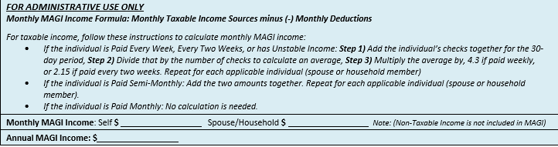
Monthly MAGI Income Formula
Monthly Income Minus (-) Deductions
Add together Clients Monthly Income, Spouse/Household Monthly Income and multiply by 12 to determine Annual MAGI Income.
Compare the Annual Income to the most recent FPL Chart to determine the clients FPL % to determine eligibility.

Slide 33
Income that is not received monthly, is converted to a monthly amount using the proper factoring method:
Step1: Add all documented amounts together
Step 2: Divide by number of documents provided
Step 3: Multiply by the appropriate conversion:
Weekly income x 4.3
(Client receives pay every week)
Bi-weekly income x 2.15
(Client collects pay every other week.)
Semi-monthly add two amounts together
(Client collects pay twice monthly)
RWISE – May produce a different number, as it uses a slightly different formula.

Slide 34
MONTHLY
USE THE PAY STUB(S) AMOUNT FOR THAT MONTH
Use Gross Income
Subtract All Applicable Deductions
Multiply x 12 for Annual Average

Slide 35
Bi-Weekly
Step1: Add all documented amounts together
Step 2: Divide by number of documents provided
Step 3: Multiply by 2.15 (Monthly average)
Step 4: Multiply by 12 (Annual average)

Slide 36
Semi-Monthly
Step1: Add all documented amounts together (Monthly Average)
Step 2: Multiply by 12 (Annual average)

Slide 37
Weekly
Step1: Add all documented amounts together
Step 2: Divide by number of documents provided
Step 3: Multiply by 4.3 (Monthly average)
Step 4: Multiply by 12 (Annual average)

Slide 38
Missing Paystubs
Clients need to provide the necessary number of paystubs.
If any paystubs are missing, the client needs to come back with the missing paystubs, or;
The Caseworker should work with the client to contact their employer to get missing documentation.
If client is using an app that has their paystub information, the client can screenshot and email the caseworker with the necessary information.

Slide 39
New Income
(“I just started a new job”)
New income may be calculated as following.
Step 1: Determine the average hours worked per week.
Step 2: Estimate the weekly gross income by multiplying the weekly estimated hours x the hourly wage.
Step 3: Determine the monthly projected gross income by multiplying the weekly gross by 4.3
Reminder: You can call a client’s employer with the client in order to get this information.

Slide 40
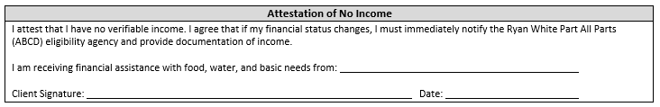
Clients who declare “no income” are required to self-report the amount and source of their household support. Zero income is not allowable unless they have no income). Clients that declare no income must verify other means of support this includes:
A letter of support from the person(s) providing in-kind support to the client.
A completed Dependent Support From (CDG 15-48)

Slide 41

HEALTH INSURANCE

Slide 42
PURPOSE
Health Insurance assistance services is the provision of financial assistance for eligible individuals living with HIV to maintain continuity of health insurance, or to receive medical and prescription benefits under a health insurance plan. This includes:
Purchasing health insurance that provides comprehensive primary care and pharmacy benefits for low-income clients that provide a full range of HIV medications,
Paying prescription drug co-pays and deductible on behalf of the client,
Providing funds to contribute to a client’s Medicare Part D True Out-of-Pocket Costs.

Slide 43
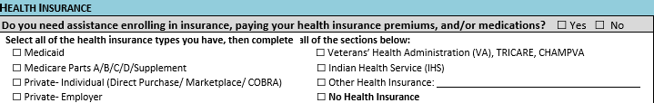
HEALTH INSURANCE
All applicants should be assessed for health insurance coverage during eligibility determination and at each re-certification.
If eligible the Ryan White program has the expectation that a client will enroll in health insurance that is available to them.

Slide 44

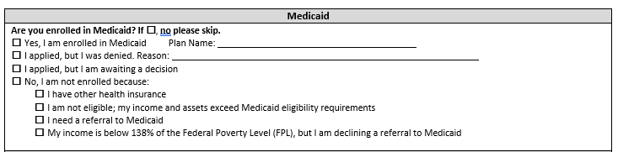
MEDICAID
Medicaid is a state and federally-funded entitlement program. The Nevada Department of Children and Families (DCF) and/or the Social Security Administration (SSA) determine Medicaid recipient eligibility.
Clients who are Medicaid eligible will not be eligible for Ryan White services where the same service is covered by Medicaid.

Slide 45
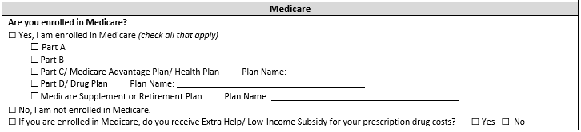
MEDICARE
Medicare is a federally-funded entitlement program administered by the Centers for Medicare and Medicaid Services.
Individuals who are eligible for Medicare must enroll in all coverage that is available before accessing Ryan White Part B services.

Slide 46
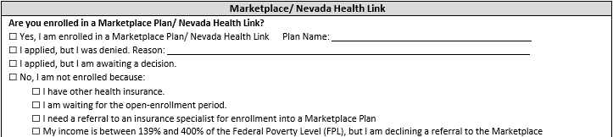
Private – Individual
(Direct Purchase/Marketplace)
Nevada Health Link connects individuals to a variety of insurance plans from different health insurance companies, as well as offers tools and resources to help individuals choose a health insurance plan.

Slide 47
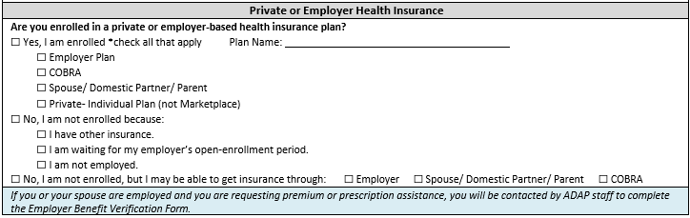
PRIVATE/EMPLOYER INSURANCE
Clients who are employed are expected to pursue insurance enrollment available to them. Similarly, if employer-based insurance is available through a spouse or a parent, clients should pursue enrollment.
Coverage as a Dependent: Clients covered by a parent or spouse’s insurance are eligible to receive assistance from the program for pharmacy deductible, co-payments, cost-sharing and the client’s portion of the premium only.

Slide 48
Proper documentation is required. It is not acceptable to take a client’s word they have no access to insurance when employed.
If a client has no insurance and employed
If the client is employed but without insurance, the client will need to provide proof that they have no access to insurance from their employer. This can be done in various ways. (for example: letter from employer, an employee handbook stating it, etc.)
Document the steps taken to ensure insurance is not available.
Refer the client for NMAP services.

Slide 49
DOCUMENTATION
Insurance Type | Description | Acceptable Screening document to submit with applications
Employer Insurance | Clients must enroll in affordable and adequate employer insurance plans | Benefit Verification Form
Spouse’s Employer Insurance | Enrollment requirements extend to spouse’s employer insurance plans regardless of spousal enrollment into the program | Benefit Verification Form
Medicare | Clients enrolled in SSDI for at least 24 months or over 65 years old | Copy of Medicare card OR application and dated screenshots of Medicare lookup.
Medicare Part D | Clients enrolled in Medicare part A and/or B | Medicare Part D card, if available otherwise documented proof of enrollment
Medicare LIS | Clients enrolled in Medicare and under 175% of the federal poverty level | Copy of Medicare card OR Application and dated screenshots
Marketplace Insurance | Private insurance is purchased through the healthcare.gov marketplace website. | Copy of Benefit Verification
Direct Purchase Insurance | Private-individual insurance purchased directly through an insurance company | Copy of Benefit Verification

Slide 50
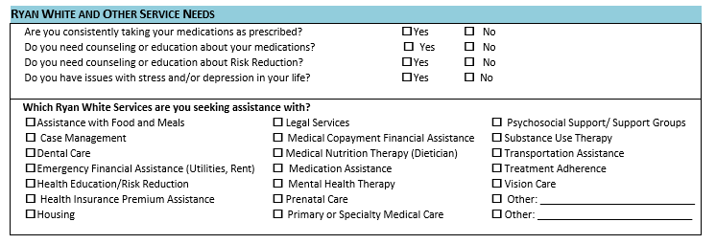
CLIENT SERVICE NEEDS ASSESSMENT

Slide 51

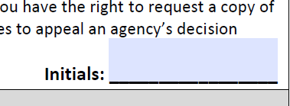
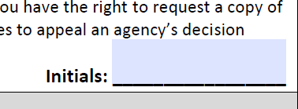
CLIENT RIGHTS & RESPONSIBILIES
Please read (or have the client read) his/her Rights and Responsibilities.
Have client initial that he/she has read and understands their rights and responsibilities, but only after he/she has acknowledged that they fully understand these rights and responsibilities and their questions and concerns have been answered.

Slide 52
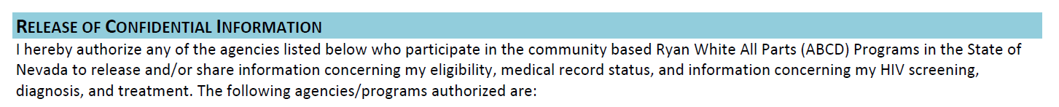
Process
Case Manager will read or have the client read the above statement and go through the list of current providers.
(fill in the name of his physician
(Optional) the client can fill in the name of his partner/spouse/other (this would be preferably his emergency contact)
ROI
Case Manager will read or have the client read the above statement and go through the list of current providers.
The client can fill in the name of their insurance provider (if applicable)
The client can fill in the name of his physician
The client can fill in the name of his partner/spouse/other (this would be preferably his emergency contact)
The client cannot choose which agencies he wishes to place on this list, and which to remove. If the question arises, assure the client that ONLY those agencies who he/she has sought services from will have access to their information.

Slide 53
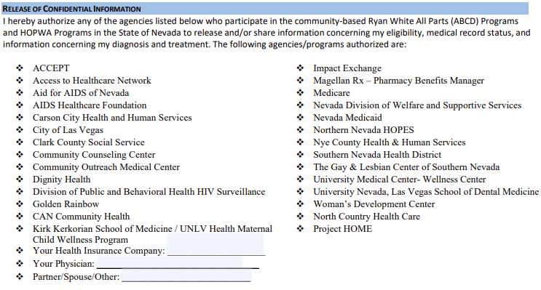
The client cannot choose which agencies he wishes to place on this list, and which to remove. If the question arises, assure the client that ONLY those agencies who he/she has sought services from will have access to their information.

Slide 54
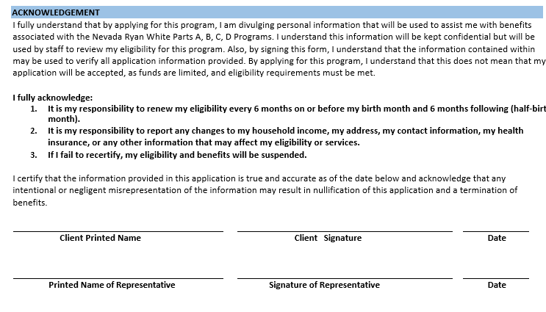

Slide 55

Signing on Behalf of a Client
Case Manger’s may sign on behalf of a client, but must do the following:
Case Manager will print the following words “Signing on Behalf of the Client” in the signature section.
Case Manger will then sign their name and date it at time of signature where appropriate.
Case Manger will annotate “Signed on Behalf of the Client” at the beginning the CAREWare service notes.
Case Manger will mail the client a Release of Information (ROI) for their signature. Emphasize to the client they need to get the signed page returned within 14 calendar days.

Slide 56
Signing on Behalf of a Client
Client needs to return a copy of the signed Release of Information (RoI) within 14 days.
Electronic signature is usable.
If client does not return the signed RoI then an agency is unable to send a referral to another agency until they receive that signature.

Slide 57
Recertification
Clients must have a comprehensive reassessment of their eligibility status every six months to determine client’s continued access to Ryan White services.
Initial and Annual Review: Clients must have a completed Universal Eligibility Application on their birthday month and provide required documentation prior to the finalization of the process.
6-Month Attestation: Case Managers must conduct an eligibility assessment during the clients ½ birthday month to determine the ability to continue access to Ryan White services.
The recertification process may be completed in person, by mail, phone, or other electronic means.
If a client has not recertified prior to the expiration of their current benefits, they are dropped from all elements of the Ryan White program.

Slide 58
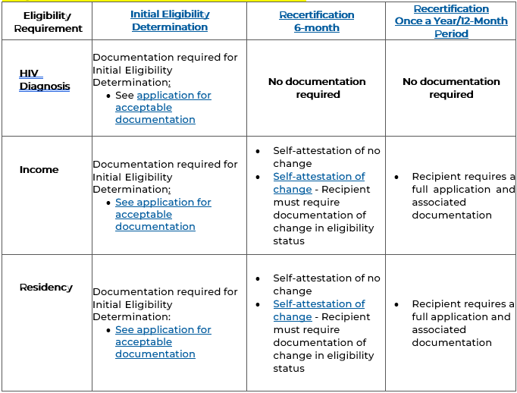
Required Documentation

Slide 59
CHANGE IN STATUS
While eligibility is not reviewed at times other than initial/returning, annual recertification and six-month recertification, it is the responsibility of all enrolled clients to keep the program updated.
Clients are expected to inform their Case Managers of any significant change in their status. When client’s status changes, please have the client submit the change with the new acceptable proof for review.
Any changes to residency should be completed and documented by using the Client Change of Information Form.
Any changes must be updated in CAREWare/RWISE within 3 business days of the reported address change.
Refusal to Divulge Information: Clients who refuse to divulge or document income will not be able to complete the financial eligibility assessment and will therefore be determined ineligible.
This includes spouses and household members counted in household size who refuse to provide appropriate information.

Slide 60
Additional Forms | Description | When to use
Request for Proof of Diagnosis (CGD 15-39) | Completed by client’s medical provider who has direct knowledge of client’s HIV diagnosis. | Utilized when a client has no medical diagnosis available and needs verification of HIV Status. This form will only be utilized at initial determination.
Dependent Support Form (CGD 15-48) | Completed by an individual who is providing the client with support and/or housing status. | Utilized when a client is receiving support from a non-governmental third party. Utilized when a client has made a declaration of no income.
Verification of Residence (CGD 15-50) | Completed by client’s landlord to establish his/her physical address for residency purposes. | When a client has a residency but has no other back-up documentation. Utilized to establish residency for eligibility purposes.
Profit and Loss Statement for Self-Employment (CGD 16-04) | Completed by a client who is self-employed or has other non-traditional income. | Utilized when client’s income is from a self-owned business (including proprietorships and partnerships), a paid professional, paraprofessional, or occupational services (such as lawn care, domestic work, handyperson, landscaping, salesperson, street entertainer, or sex workers, etc.) Utilized to establish income.
Dental Insurance Enrollment Form (CGD 19-08) | Completed by Client who lacks standalone dental insurance or in need of cost-sharing assistance. | Completed during initial eligibility and every six months (during recertification)
ADDITIONAL PAPERWORK
The following are optional forms to be completed with the specific purpose of determining client’s initial and/or continued eligibility.

Slide 61


Slide 62
Ryan White Contact Information
PART A
PART B
M. GABRIEL COLBAUGH
Email: m.Colbaugh@health.nv.gov
P: (702) 486-0928
Jose Alcazar
Email: jose.alcazar@clarkcountynv.gov
P: (702) 455-5845
TONY GARCIA
Juan.Garcia@clarkcountynv.gov
P: (702) 455-7255

Slide 63
PROGRAM QUESTIONS: Part B
CAREWare Related CAREWareHelp@helath.nv.gov
Liberty Dental NVDental@health.nv.gov
RWPB & NMAP Programmatic Issues NVRWPB@health.nv.gov
RWPB, NMAP & HOPWA Fiscal Issues NVRWFiscal@health.nv.gov
RWPB & NMAP Quality Management NVCQM@health.nv.gov
HOPWA Programmatic Issues NVHOPWA@health.nv.gov
PROGRAM QUESTIONS: Part A
CAREWare/RWISE Issues https://lvtgarwise.jprog.net/CCPortal/

Slide 64
For Further Information
Las Vegas TGA https://lasvegastga.com
End HIV Nevada https://endhivnevada.org
HRSA https://www.hrsa.gov
Universal Eligibility Manual
Dental Insurance Forms
2023 Poverty Guidelines
https://aspe.hhs.gov/topics/poverty-economic-mobility/poverty-guidelines

Slide 65
Have a Good Day

