Slide 1
Liberty Dental insurance
M. Gabriel Colbaugh, Program Office
Nevada Office of HIV
May 31, 2023

Slide 3
Eligibility requirements
Review the application
Entering new clients and returning
Entering renewing clients
Questions and Answers

Slide 4
DENTAL INSURANCE
Anyone eligible for Ryan White services can be eligible for Dental
Cannot have any other dental coverage such as through a spouse, guardian, or employer
One exception is Medicaid Dental: Customer can have both Medicaid and Ryan White Dental

Slide 5
DENTAL INSURANCE
Eligibility Specialists will fill out the Dental Insurance Enrollment Form as part of the Universal Eligibility packet for those clients enrolling in dental coverage.
19-08 Dental Form on the endhiv.org website
19-08a is a Primer for additional guidance

Slide 6
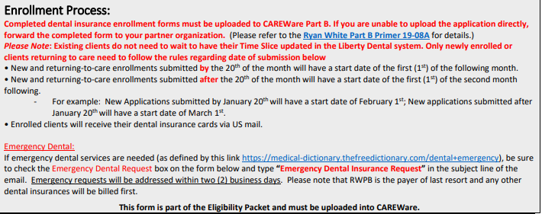
LIBERTY DENTAL ENROLLMENT FORM
20th and before start the first of the next month
Application Date – 20th June
Eligibility Start Date – 1st July
21st and BEYOND start the first of the month after the next
Application Date – 21st June
Eligibility Start Date – 1st August
Emergency Request start the 1st of the current month.
Application date - 13th June
Eligibility Start Date – 1st June

Slide 7
LIBERTY DENTAL ENROLLMENT FORM
5/8/2022
11/31/2022
MO Thompson
702-486-0872
6/1/2022
11/31/2022
Ryan White Eligibility Dates – Dates from RW Eligibility Document
Start Date: Date document completed (8th May 2022)
End Date: Last day of appropriate month (30th November 2022)
Liberty Dental Eligibility Dates
Start Date: ALWAYS Use LD Eligibility Information
If client applies for LD at the same time as Ryan White (1st June 2022)
If client comes in a later date requesting LD
Use LD Eligibility Information
End Date: ALWAYS Match With RWPB Eligibility End Date

Slide 8
LIBERTY DENTAL ENROLLMENT FORM
Balboa
Rocky
Male
RCBL08171U
08/17/1999
567-555-8521
x
301 Cobblestone Way
Henderson
NV
89127
Client General information shall mimic RWHAP (and CAREWare)
Emergency Request only if the client request it
Mailing address only needed in different from Home address
SSN or TIN category will be used for verification of other health benefits. This category may be left open if the client does not have an SSN or TIN.

Slide 9
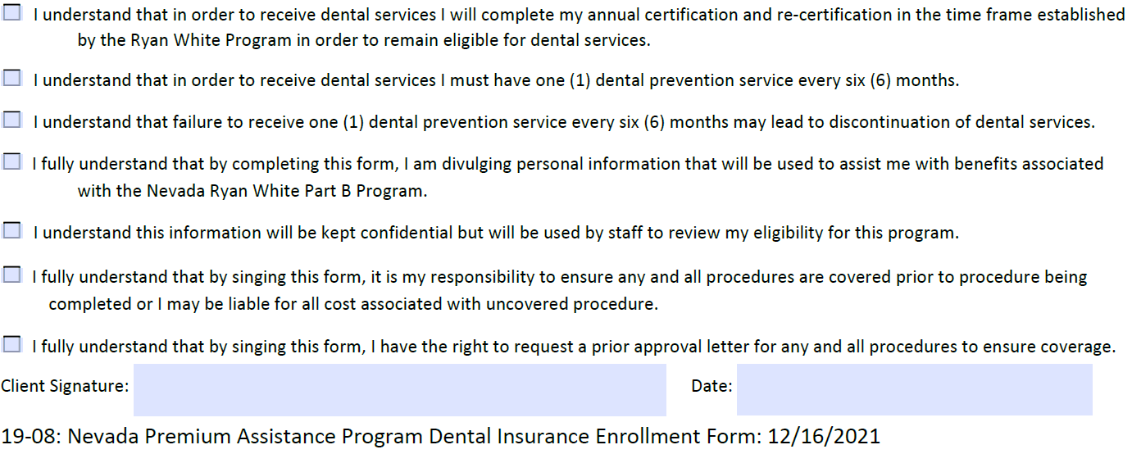
LIBERTY DENTAL ENROLLMENT FORM
The client must read the form, check the boxes and sign the form.
Ensure clients fully understand their dental insurance (i.e., approved procedures and eligibility dates)
Liberty Dental costumer care number (all clients should have) 888 - 401-1128.

Slide 10
LIBERTY DENTAL ENROLLMENT FORM
Make sure that when finished, you upload the eligibility form to CAREWare under the client’s name

Slide 11
LIBERTY DENTAL NEW CLIENT
Start enrollment process.
Client that has never been RWPB Liberty Dental.
Summary of Benefits – These are benefits offered by Liberty Dental.

Slide 12
LIBERTY DENTAL NEW CLIENT
Tier – Employee only
Member Number – uncheck auto-assign and use Ryan White URN
Relationship – Self
Effective Date – Liberty Dental current plan Effective Date
Expiration Date - Ryan White Eligibility End Date

Slide 13
LIBERTY DENTAL NEW CLIENT
First Name – Legal First Name
Last Name – Legal Last Name
Gender – Client identifies

Slide 14
LIBERTY DENTAL NEW CLIENT
Address 1 - Address where client receives mail.
City – City where client receives mail.
State - Where client receives mail.
Zip – Zip code where client receives mail.
Enroll – Enroll client in Liberty Dental insurance plan.

Slide 15
HOW TO FIND CLIENTS
SSN# - Do not use
Subscriber – Use Ryan White URN
AS of Date – (can be left blank) Uses that date to search for active plans as of that date.
Last Name - Search by Last Name

Slide 16
UPDATING DENTAL COVERAGE DATES
RCBL08171U
Balboa
Rocky
08/17/1999
RCBL08171U
Balboa
Rocky
08/17/1999
View – Select to update client details.

Slide 17
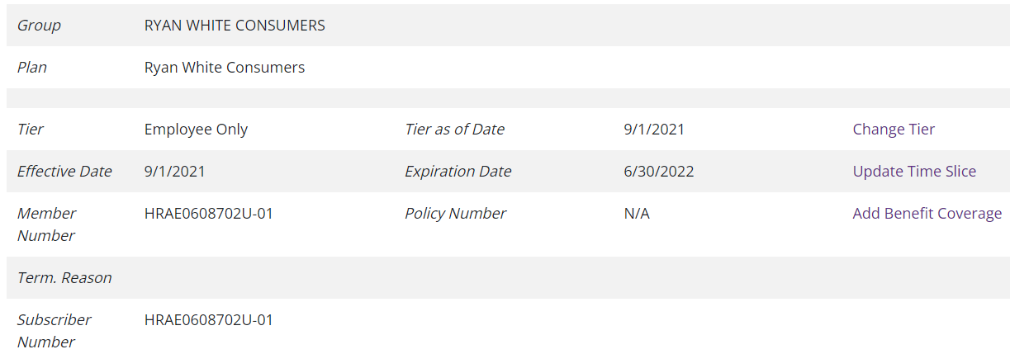
UPDATING DENTAL COVERAGE DATES
5/1/2021
5/1/2021
8/31/2022
RCBL08171U
RCBL08171U
Change Tier – Not used
Update Time Slice – Updating current clients whose eligibility has not expired (six-month eligibility or annual certification)
Add Benefit Coverage – For clients who have fallen out of care and are returning

Slide 18
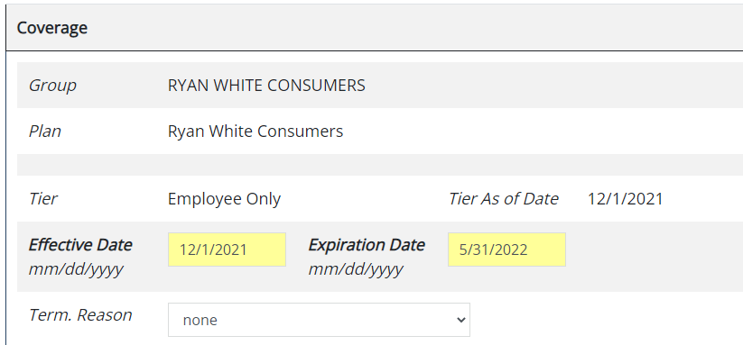
UPDATING TIME SLICES
5/1/2021
Effective Date – Date original current plan started (DO NOT CHANGE)
Expiration Date – New Expiration date from Ryan White plan.
Save

Slide 19
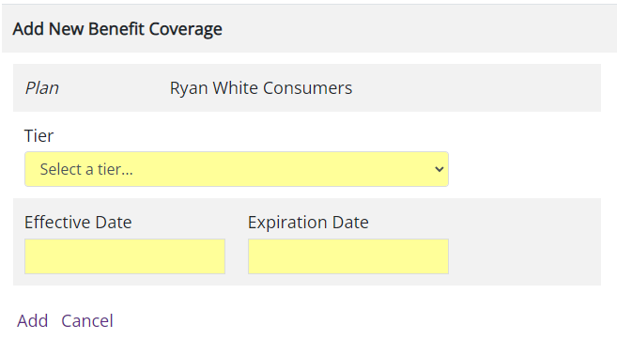
ADD NEW BENEFIT COVERAGE
For clients who have fallen out of care and are returning.
Tier – Employee only.
Effective Date – New Liberty Dental Effective Date.
Expiration Date – Ryan White Expire Date.
Save

Slide 21
M. Gabriel Colbaugh, m.Colbaugh@health.nv.gov, 702-486-0928
General questions, please email link below:
nvdental@health.nv.gov

Slide 22
LD – Liberty Dental
DPBH – Department of Public and Behavioral Health

