Slide 1
Nevada Ryan White Eligibility 101
PRESENTERS:
Part B: Marques Thompson, Sarah Cowan,
Gabe Colbaugh

Slide 2
Learning Objectives
Identify specific eligibility requirements for Nevada Ryan White Universal Eligibility.
Identify acceptable forms and verifications of identification, proof of diagnosis, proof of residency, and proof of income level.
Understand eligibility and enrollment for Ryan White health and dental insurance process.

Slide 3
OBJECTIVES OF ELIGIBLITY
Ryan White funds are intended to support only the HIV-related needs of eligible individuals.
The objectives of the eligibility determination are to:
Establish client eligibility before providing services.
Ensure all clients adhere to biannual (twice a year) recertification requirements.
Collect basic applicant information to facilitate client identification, follow-up, and HRSA required performance measurements.
Inform the applicant of services that are available and what the client can expect if they are determined eligible for services.
Refer the applicant for case management and other services and programs, if eligible.

Slide 4
The following persons may apply for services:
Any individual seeking services.
The individual’s legal guardian.
A person designated in the individual’s medical power of attorney (i.e., their court-appointed representative or legal representative). Proper documentation must be collected at initial determination and re-determination to verify guardianship or medical power of attorney.
NOTE: Minors Seeking Services: Minors (under 18 years old) may receive services. Those seeking services without parental consent will be determined on a case-by-case basis with the approval of Ryan White Program Administrators.

Slide 5
To be eligible for Ryan White services a client must meet the following criteria:
Have a Positive HIV Diagnosis
Household income under 400% of the Federal Poverty Level (FPL).
Be a resident of the State of Nevada (for Part A services clients must reside within the TGA).
Per program guidance from HRSA, categorically eligible individuals that test positive for HIV are eligible for care under the Ryan White Program. including NMAP, regardless of immigration status.

Slide 6
NEVADA RYAN WHITE UNIVERSAL ELIGIBILITY
TRAINING ON
ELIGIBILIY PROCEDURES FOR NEVADA RYAN WHITE HIV/AIDS PROGRAM

Slide 7
APPLICATION, START & END DATE
Application Date:
Date the complete application was received by the processing agency.
Start Date:
The Eligibility Start Date will always be the date the client has completed the eligibility packet.
End Date:
The Eligibility End Date will always be the last day of the month.
Eligibility Start and End dates are determined by the actual birth month of the client.

Slide 8
GAP CERTIFICATION & ALIGNMENT
EXPLAINED
Gap Certification and Alignment are the months a consumer is eligible prior to their birthday / half birthday cycle of registration.
*Applies to active Ryan White consumers

Slide 9
CERTIFICATION RULES
Initial certification – One time only
Annual certification – during birth month or client coming back into care
Recertification – during half birthday month
Can not have two consecutive recertifications
Can have two consecutive annual certifications

Slide 10
GAP CERTIFICATION & ALIGNMENT BREAK DOWN
In order to align a client to birthday/half-birthday eligibility dates eligibility specialist must:
Identify the client’s birthday month and half birthday month.
Identify the client’s enrollment start date (application fully completed date).
Eligibility end date will always be the birthday / half birthday month (following the rule of never one (1) month of eligibility or more than seven (7) months of eligibility).

Slide 11
GAP CERTIFICATION & ALIGNMENT
EXAMPLES
Client A
Initial eligibility Date: 4/12/2022
Birthday: 7/15/1999
Half Birthday month – January
Client B
Initial eligibility Date: 1/12/2022
Birthday: 12/22/2000
Half Birthday month – June
Client D
Initial Eligibility Date: 3/2/2022
Birthday: 4/28/1958
Half Birthday month: ???
Client E
Initial eligibility Date: 9/21/2022
Birthday: 5/03/1982
Half Birthday month: ???
Client A
4/12/2022 Initial certification
7/2022 Birthday month Annual certification
1/2023 Half birthday month Recertification
Client B
1/12/2022 Initial certification
6/2022 Half birthday month recertification
12/2022 Birthday month annual certification
Client D
??? Initial Annual certification
??? Recert or Annual certification
??? Recert or Annual certification
Client E
??? Initial Annual certification
??? Recert or Annual certification
??? Recert or Annual certification

Slide 12
Mailed Applications
Mailed and/or emailed applications are acceptable with verbal verification from the client.
In this case the Eligibility start date will be from the date the application & documentation was received/dated and reviewed for completeness by the eligibility Subrecipient.
Eligibility packets should be reviewed within 24 hours after they are received by the Subrecipient, so the client’s eligibility is not unnecessarily delayed

Slide 13
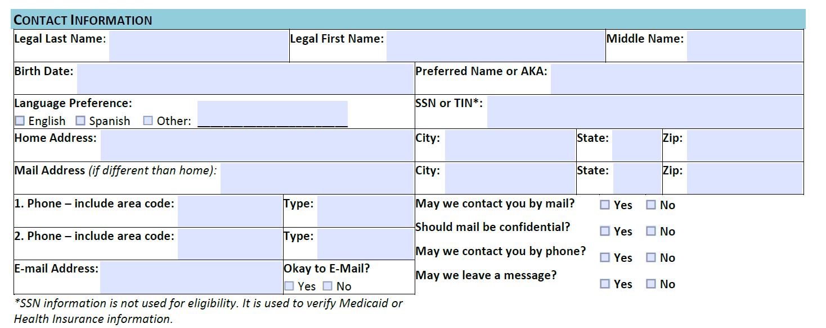
CONTACT INFORMATION
If client has any special instructions for being contacted, please make note on the application and in their case notes in CAREWare.
SSN or TIN: are optional not required.

Slide 14
Emergency Shelters & Trafficking Victims
Contact their shelter case manager to review the policy of the shelter.
Use client’s P.O. Box for mailing address (if they have one); or
Write “confidential address” on the physical address section of the application and also in CAREWare/RWISE Demographics tab.
In the Residency section check the Verification of Residence Form or attach a verification letter from the shelter representative

Slide 15
Emergency Contact
An emergency contact is the first-person case managers will contact for a client related emergency.
An emergency contact doesn't have to be a close relative or friend. It can be literally anybody.
If it is truly the case that a client literally doesn’t identify an emergency contact, it's also OK to just not have an emergency contact.
This information is a confidential personal record and is only provided to others on a need-to-know basis.
If the emergency contact does not know the client's status, it is up to the case manager to keep said status confidential when communicating with the client’s emergency contact.

Slide 16
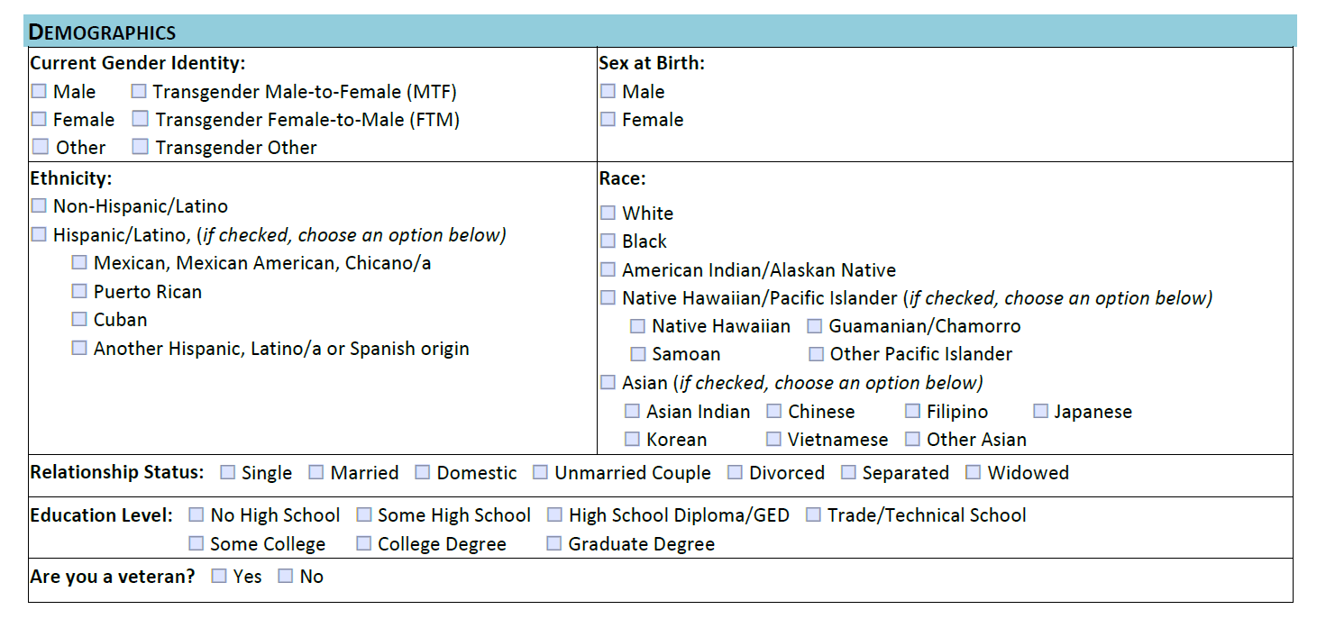
DEMOGRAPHICS
Demographic information allows us to better understand certain background characteristics of our clients. This information helps the Ryan White Program communicate effectively with our service community, as well as understand our client(s) varied cultures, which may affect their health.

Slide 17
HIV Status and Diagnosis Information
An applicant is required to have documentation of a medical diagnosis of HIV from a laboratory test confirming the client’s HIV infection for their initial determination of eligibility.
Documentation of HIV-positive status must be reviewed and confirmed before initial enrollment by a case manager.

Slide 18
PROOF OF DIAGNOSIS
Any proof of diagnosis document must include the applicant’s full, legal name.

Slide 19
Not Acceptable Proof
The following are not considered acceptable as proof of diagnosis:
Any point of care rapid test not approved by the FDA for confirmatory purposes
Anonymous test results or a test result with the applicant/client’s name missing, or name of testing laboratory missing.
Any documentation with an undetectable viral load test

Slide 20
Exposed Infants
Exposed infants of HIV-positive mothers can be served with documentation of the mother’s HIV-positive status up to the age of 12 months.
Children 12 months or older must meet the same criteria for proof of HIV as listed above to continue services.
All infants will be referred to Ryan White Part D.

Slide 21
BASIC MEDICAL

Slide 22
RESIDENCY
For eligibility, residency refers to clients who make Nevada their home. A specific number of weeks or months in Nevada are not required to be considered as a resident in Nevada; however, a client’s intent to remain in Nevada is of interest, particularly for medical and treatment services
Part A TGA residency is Clark County (NV), NYE County (NV) and Mohave County (AZ)
If the client is to be incarcerated for a time period greater than 3 months, they are not Ryan White eligible, please refer the client to the Department of Corrections for further assistance.

Slide 23
RESIDENCY
DOCUMENTATION
All clients must provide one (1) residency document from the list below indicating Nevada residency.

Slide 24
NOTIBLES AND EXCEPTIONS
The residency address may be a PO Box if:
The recipient has another means to verify the address (such as a utility bill)
If the United States Postal Service (USPS) has not established a residential address for the location. This is often the case on Native American Tribal Reservations.
The following Nevada Common Guidance Document(s) may also be used to establish residency:
CGD 15-48 Dependent Support Form
CGD 15-50 Verification of Residence

Slide 25
ATTESTATION OF HOMLESSNESS
If client states that she/he is homeless or lying-in a shelter with no verifiable residence, please have them complete the Attestation of Homelessness in the initial and/or annual recertification application.
HUD Defines Homeless as:
(1) An individual or family who lacks a fixed, regular, and adequate nighttime residence, meaning:
(i) An individual or family with a primary nighttime residence that is a public or private place not designed for or ordinarily used as a regular sleeping accommodation for human beings, including a car, park, abandoned building, bus or train station, airport, or camping ground;
(ii) An individual or family living in a supervised publicly or privately operated shelter designated to provide temporary living arrangements (including congregate shelters, transitional housing, and hotels and motels paid for by charitable organizations or by federal, State, or local government programs for low-income individuals); or
(iii) An individual who is exiting an institution where he or she resided for 90 days or less and who resided in an emergency shelter or place not meant for human habitation immediately before entering that institution;
(CFR 20107 Title 24 Vol 3 Part 578.3)

Slide 26
Frequency for Collecting Residency Documents
Proof of residency is required at least annually.
Residency documents are collected during the new client intake, full birthday renewals and at 6-month attestation (when applicable).
Any changes to residency should be completed and documented by using the 6-month attestation form.
Any changes must be updated in CAREWare/RWISE within 3 business days of the reported address change.

Slide 27
HOUSEHOLD SIZE
Applicant + spouse + (tax) dependents = household

Slide 28
Spouses/Domestic Partners
When determining an individual’s household size, spouses/domestic partners must be included. This includes both traditional and same gender couples.
It does not matter if they file a joint or separate tax return or if one expects to be claimed as tax dependent. They must be counted in the household size.

Slide 29
Household documents are collected during the new client intake, full birthday renewals and at 6-month attestation (when applicable).
Household income will be reassessed annually.
Anytime there is a change in family composition that results in an increase or decrease in income clients must report this to their Case Managers.
Any changes should be completed and documented by using the 6-month attestation form.
Any changes must be updated in CAREWare/RWISE within 3 business days of the reported change.

Slide 30
INCOME
The Nevada Ryan White Program(s) uses MAGI to calculate client and household taxable income.
The calculated income is used to identify the client’s Federal Poverty Level (FPL).

Slide 31
INCOME – POINTS OF DISCUSSION
For Nevada, eligibility is for those who have a household income that is at, or below 400% of the Federal Poverty Level (FPL).
Proof of income must be provided for the client and each adult member of his or her household and reviewed by a Case Manager prior to initial enrollment.
Gross income is the amount used when determining eligibility (except where the client reports he/she is self-employed).
Gross Income versus Net Income
Gross income is commonly defined as the amount of an individual’s income before any deductions or taxes are taken. Section 61 of the Internal Revenue Code defines gross income as “all income from whatever source derived.”
Net Income for an individual is the gross income minus taxes, allowances, and deductions. An individual’s net income is used to determine how much income tax is owed.

Slide 32
INCOME SOURCE DOCUMENTS
Proof of income must be provided for the client and each contributing member of their Assistance Unit (including spouse and tax dependents).
Any income source documentation provided must include the applicant’s name.

Slide 33
Non-Taxable Income and/or Unearned Income is all income that is not earned from employment. It includes benefits from other programs and must be documented to determine eligibility.

Slide 34
Unearned Income
Income that is not earned from employment but must also be documented to determine eligibility.
Examples: Temporary cash Assistance for Needy Families (TANF); Pension or Retirement Benefits; SSI/SSDI, Veterans Pension Benefits and Unemployment Benefits (this does not include payments from federal COVID dollars)

Slide 35
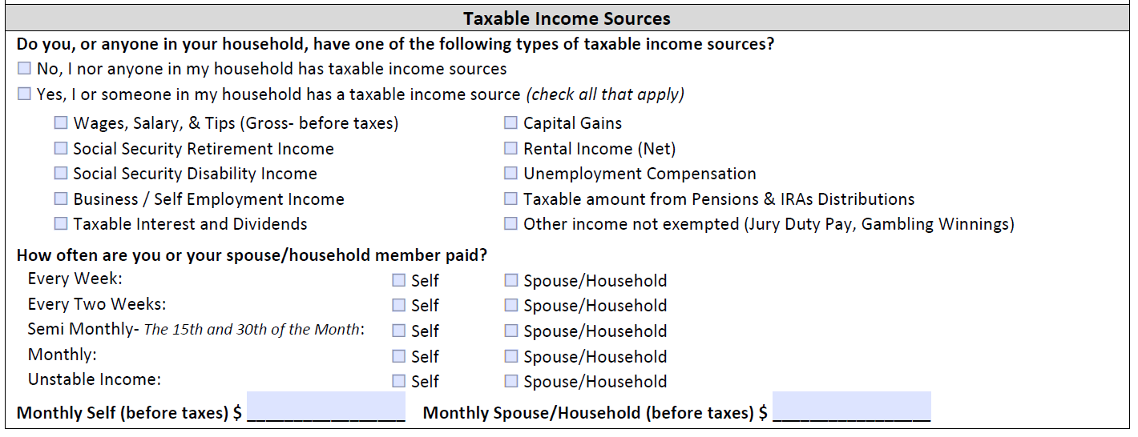
Taxable income is the portion of a person’s or company’s gross income that the government deems subject to taxes.
Taxable income consists of both earned and unearned income.

Slide 36
WHAT IS CONSIDERED TAXABLE INCOME
For eligibility determination Household income includes the client’s income and all income of anyone the client claims on their taxes or the income of someone who claims the client as a dependent on their taxes.
Income is determined by the best estimate of earned income and any unearned income received regularly.
Income earned in a foreign currency must be converted to US dollars in order to determine what the actual earned income is.
https://www.xe.com/currencyconverter/

Slide 37
Taxable Income Sources
Employment Income
For individuals with regular, non-seasonal employment, documentation must be the most current possible (within a 30 day period). The most recent documentation can be no more than 30 days older than the date that the application was signed by the client.
For clients employed seasonally by the same employer, documentation should be a current pay stub that shows the year-to-date earnings.
Employment income includes any overtime pay, tips, bonuses and commissions. All must be reported.
Persons who have multiple employers and/or job positions over the course of the year make it difficult to calculate annual income. In these cases, income documentation may be supported by providing the most recently filed Federal Tax Return.
Spousal Income
Spousal income must be reported and documented for any client who is reported as married. This must be included on the client’s application and the documentation requirements are the same as those for the client.

Slide 38
Other Considerations
Married Couples
In the case of married couple living together, each spouse is included in the household size of the other spouse regardless of whether they expect to file joint tax return.
Domestic Couples (NRS 122A.100)
Domestic partners will be treated as spouses in Nevada for determining eligibility.
May be considered a step-parent to their partner’s minor children
Children adopted by both partners may be claimed as a dependent by either partner but cannot be claimed by both
Accept client statement for verification of household composition.
Divorced Couples (IRS 501)
If a couple is divorced under a final decree by the last day of the year they are considered unmarried for the whole year.

Slide 39
OTHER INCOME SOURCES
Non-Traditional Income:
Clients with non-traditional income, that are either self-employed, do not receive a paystub, or are paid in cash (must complete Common Guidance Document (CGD) 16-04: Profit and Loss Statement for Self-Employment).
This includes clients working for cash payment such as day laborers, Las Vegas strip/Freemont street entertainers, and sex workers.
Seasonal Pay:
Clients with intermittent or seasonal pay resulting in unsubstantial payment documentation must provide the most recent proof of income.
Unemployed Clients:
Clients that are unemployed and not receiving any Federal/State assistance such as General Assistance, SSI or SSDI may use the Profit and Loss Statement for Self-Employment (CGD 16-04) to document how the client supports themselves.

Slide 40
Not Considered Income
The following are not to be considered as income sources when determining eligibility:
Supplemental Nutrition Assistance Program (SNAP), previously known as Food Stamps, is not considered income when determining eligibility.
Financial Aid, including scholarships and fellowships, received by individuals attending school is not considered income when determining eligibility.
One-time payments (for example CARES Act subsidies) are not considered income when determining eligibility
401K, if not accessed.
Non-accessible income (such as trust funds).
One-time lump-sum payments (such as a bonus).

Slide 41
Unpredictable Income
Unpredictable income is exempt. Consider income unpredictable if both of the following conditions apply:
The anticipated income will be less than or equal to $30 in a calendar quarter; and
The income is received too infrequently or too irregular to be reasonably anticipated.
Consider this client to have “no income”

Slide 42
Self-Employment Income
Self-employment income includes, but is not limited to:
Small businesses, including proprietorships and partnerships.
Paid professional, paraprofessional, or occupational services such as lawn care, domestic work, handyperson, landscaping, farming, or salesperson.
Royalty or honoraria from intellectual property or authorship.
If the client has not been self-employed long enough to have filed taxes, the client can submit records of their monthly self-employment income for at least the past three months.
The Profit and Loss Statement for Self-Employment (CGD 16-04) may serve as proof of income in these cases.

Slide 43
IRREGULAR PAY
Households which, by contract or self-employment, receive their annual income in a period of time shorter than one year shall also have that income averaged over a 12-month period provided the income from the contract is not received on an hourly or piecework basis. These households may include some school employees, sharecroppers, farmers, and other self-employed households. This does not include migrant or seasonal farm workers.
When converting and projecting earnings, do not include bonuses, holiday pay, commissions and/or overtime, unless it is received on a regular basis or the holiday pay is received in lieu of regular pay (i.e., vacation pay).

Slide 44
Resources
Resources will not be counted when determining eligibility.

Slide 45
Deductions
Currently monthly budgeting only allows pre-tax deduction taken on a monthly basis or taken in the budget month to be included in eligibility determination.

Slide 46
Monthly MAGI Income Formula
Monthly Income Minus (-) Deductions
Add together Clients Monthly Income, Spouse/Household Monthly Income and multiply by 12 to determine Annual MAGI Income.
Compare the Annual Income to the most recent FPL Chart to determine the clients FPL % to determine eligibility.

Slide 47
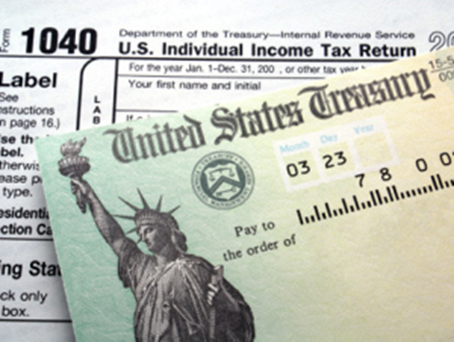
Monthly income will be based on a Best Estimate of MODIFIED AJUSTED GROSS INCOME and any unearned income received regularly.
Financial eligibility will be based on current monthly income.
A 30-day period will be used to calculate a best estimate.
The 30-day period begins the day prior to the application date.

Slide 48
Income that is not received monthly, is converted to a monthly amount using the proper factoring method:
Step1: Add all documented amounts together
Step 2: Divide by number of documents provided
Step 3: Multiply by the appropriate conversion:
Weekly income x 4.3
(Client receives pay every week)
Bi-weekly income x 2.15
(Client collects pay every other week.)
Semi-monthly add two amounts together
(Client collects pay twice monthly)
RWISE – May come up with a different number, as it uses a slightly different formula.

Slide 49
MONTHLY
USE THE PAY STUB(S) AMOUNT FOR THAT MONTH
Use Gross Income
Subtract All Applicable Deductions
Multiply x 12 for Annual Average

Slide 50
Monthly
UNLV
2020 University Dr |  |  |  | EARNING STATEMENT
Las Vegas, NV 89122
Employee name | Social Sec ID | Employee ID | Check NO. | Pay Period | Pay Date
Mary Tran | XXX-XX-9251 | 6631 | 458 | July 1 - 31 | 2-Aug
Earnings | Rate | Hours | Current | Deductions | Current | Year to Date
$ 400.00 | 0 | 0 |  | FEDERAL TAX | $ 0 | $ 0
 |  |  |  | FICA SS TAX | $ 0 | $ 0
 |  |  |  | FICA MEDICARE | $ 0 | $ 0
 |  |  |  | STATE TAX | $ 0 | $ 0
YTD Gross | YTD Deductions | YTD Net Pay | Current Total | Current Deductions | Net Pay
$ 400.00 | $ 0.00 | $ 800.00 |  | $ 0.00 | $ 800.00

Slide 51
Pay Stub #1
UNLV
2020 University Dr |  |  |  | EARNING STATEMENT
Las Vegas, NV 89122
Employee name | Social Sec ID | Employee ID | Check NO. | Pay Period | Pay Date
Mary Tran | XXX-XX-9251 | 6631 | 458 | July 1 - 31 | 2-Aug
Earnings | Rate | Hours | Current | Deductions | Current | Year to Date
$ 400.00 | 0 | 0 |  | FEDERAL TAX | $ 0 | $ 0
 |  |  |  | FICA SS TAX | $ 0 | $ 0
 |  |  |  | FICA MEDICARE | $ 0 | $ 0
 |  |  |  | STATE TAX | $ 0 | $ 0
YTD Gross | YTD Deductions | YTD Net Pay | Current Total | Current Deductions | Net Pay
$ 400.00 | $ 0.00 | $ 800.00 |  | $ 0.00 | $ 800.00
July Pay:
$400
Monthly Pay:
$400
Annual Pay:
$4,800

Slide 52
Bi-Weekly
Step1: Add all documented amounts together
Step 2: Divide by number of documents provided
Step 3: Multiply by 2.15 (Monthly average)
Step 4: Multiply by 12 (Annual average)

Slide 53
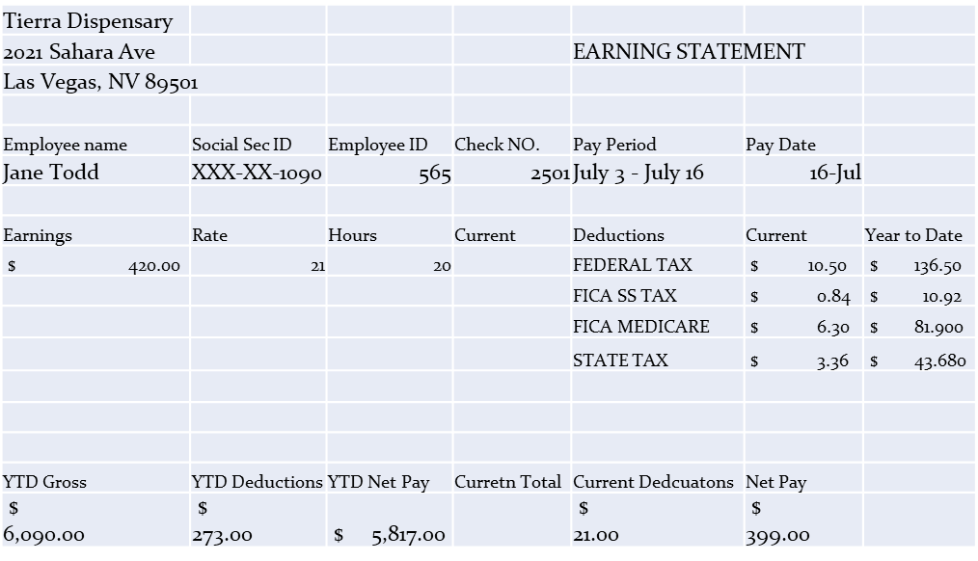
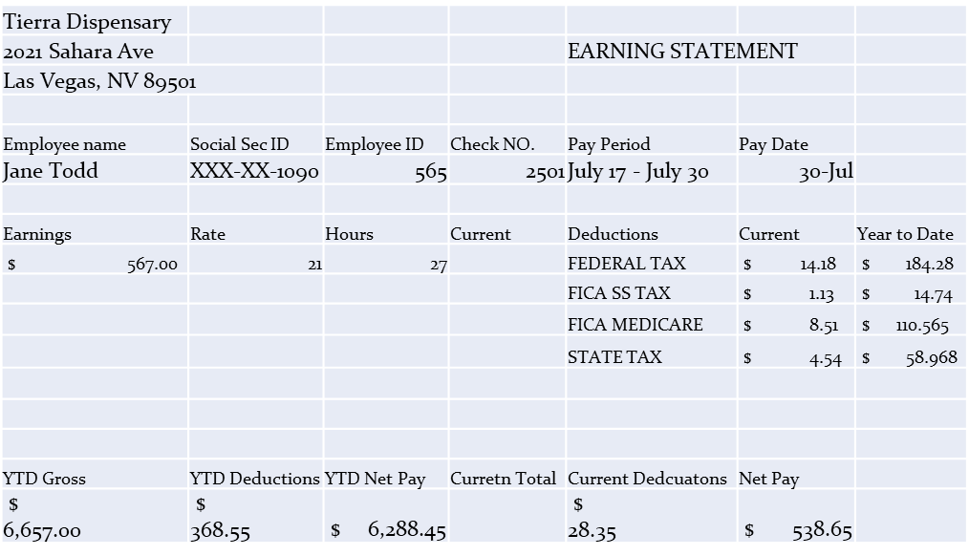
Pay Stub #1
Pay Stub #2

Slide 54
Pay Stub #1
Pay Stub #2
July Pay:
420+567=$987
Monthly Pay:
$987/2 = $493.50
Avg. Monthly Income:
$493.50 x 2.15 = $1,061.03
Annual Pay:
$12,732.30

Slide 55
Semi-Monthly
Step1: Add all documented amounts together (Monthly Average)
Step 2: Multiply by 12 (Annual average)

Slide 56
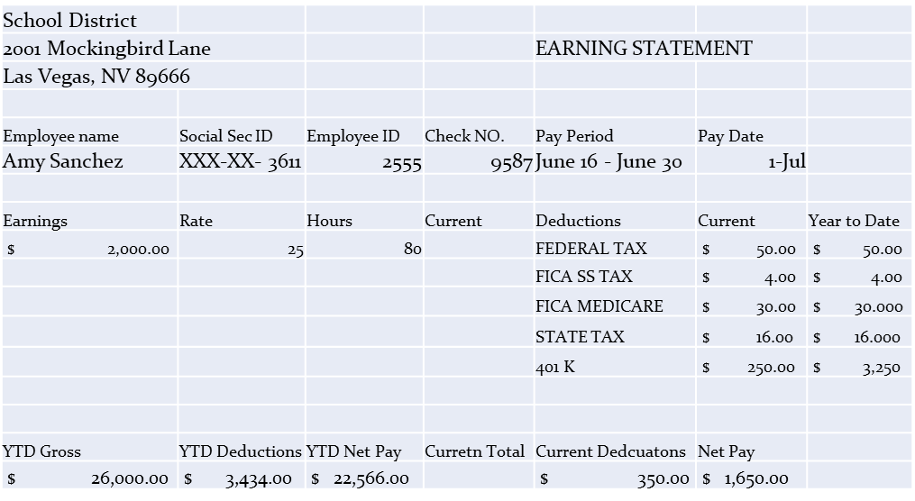
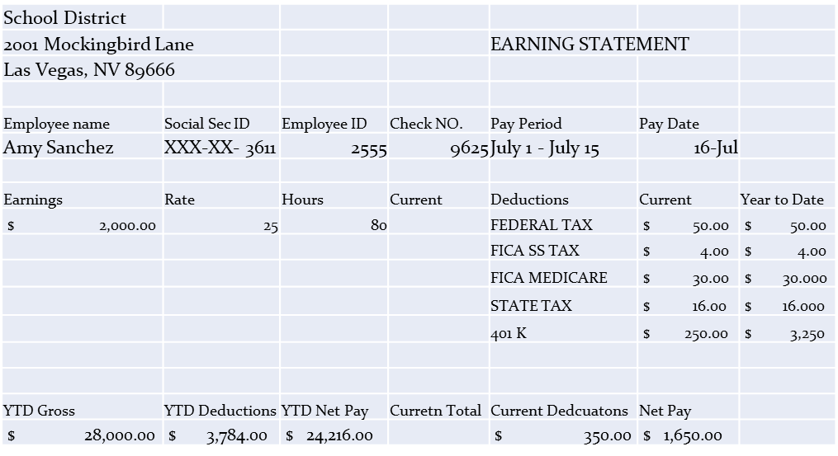
Pay Stub #1
Pay Stub #2

Slide 57
Pay Stub #1
Pay Stub #2
July Pay:
$2,000 + $2,000 = $4,000
Monthly Pay:
$4,000
Deductions:
$250 + $250 = $500
Avg. Monthly Pay:
$3,500
Annual Pay:
$42,000

Slide 58
Weekly
Step1: Add all documented amounts together
Step 2: Divide by number of documents provided
Step 3: Multiply by 4.3 (Monthly average)
Step 4: Multiply by 12 (Annual average)

Slide 59
Pay Stub #1

Slide 60
Pay Stub #3
Pay Stub #4

Slide 61
Weekly Pay: $840+$756+$735 = $2,331
Deductions: $75+$75+$75 = $225
Avg Weekly Pay: $702
Avg Monthly Pay: $3,018.60
Avg Yearly Pay: $36,223.20

Slide 62
New Income
(“I just started a new job”)
New income may be calculated as following.
Step 1: Determine the average hours worked per week.
Step 2: Estimate the weekly gross income by multiplying the weekly estimated hours x the hourly wage.
Step 3: Determine the monthly projected gross income by multiplying the weekly gross by 4.3

Slide 63
Clients who declare “no income” are required to self-report the amount and source of their household support. Zero income is not allowable unless they have no income). Clients that declare no income must verify other means of support this includes:
A letter of support from the person(s) providing in-kind support to the client.
A completed Dependent Support From (CDG 15-48)

Slide 64
Frequencies for Collecting Data
All clients, must attest if there has or has not been a significant change in income that would impact eligibility. Documentation is required during the new/returning program application and during the annual (birth month) certification. Remote self-attestation of no change may be utilized during the partial (half-birth month) recertification.
Changes in Income
While eligibility is not reviewed at times other than initial/returning, annual re-enrollment and six-month recertification, it is the responsibility of all enrolled clients to keep the program updated.
Clients are expected to inform their Case Managers of any significant change (increase or decrease) in their household income. When client income changes, please have the client submit the change with the new acceptable proof for review.
Refusal to Divulge Information
Clients who refuse to divulge or document income will not be able to complete the financial eligibility assessment and will therefore be determined ineligible.
This includes spouses and household members counted in household size who refuse to provide appropriate information.

Slide 66
HEALTH INSURANCE

Slide 67
PURPOSE
Health Insurance assistance services is the provision of financial assistance for eligible individuals living with HIV to maintain continuity of health insurance, or to receive medical and prescription benefits under a health insurance plan. This includes:
Purchasing health insurance that provides comprehensive primary care and pharmacy benefits for low-income clients that provide a full range of HIV medications,
Paying prescription drug co-pays and deductible on behalf of the client,
Providing funds to contribute to a client’s Medicare Part D True Out-of-Pocket Costs.

Slide 68
All applicants should be assessed for health insurance coverage during eligibility determination and at each re-certification.
If eligible the Ryan White program has the expectation that a client will enroll in health insurance that is available to them.

Slide 69
MEDICAID
Medicaid is a state and federally-funded entitlement program. The Nevada Department of Children and Families (DCF) and/or the Social Security Administration (SSA) determine Medicaid recipient eligibility.
Clients who are Medicaid eligible will not be eligible for Ryan White services where the same service is covered by Medicaid.

Slide 70
MEDICARE
Medicare is a federally-funded entitlement program administered by the Centers for Medicare and Medicaid Services.
Individuals who are eligible for Medicare must enroll in all coverage that is available before accessing Ryan White Part B services.

Slide 72
PRIVATE/EMPLOYER INSURANCE
Clients who are employed are expected to pursue insurance enrollment available to them. Similarly, if employer-based insurance is available through a spouse or a parent, clients should pursue enrollment.
Coverage as a Dependent: Clients covered by a parent or spouse’s insurance are eligible to receive assistance from the program for pharmacy deductible, co-payments, cost-sharing and the client’s portion of the premium only.

Slide 73
Proper documentation is required. It is not acceptable to take a client’s word they have no access to insurance when employed.
If a client has no insurance and employed
If the client is employed but without insurance, the client will need to provide proof that they have no access to insurance from their employer. This can be done in various ways. (for example: letter from employer, an employee handbook stating it, etc.)
Document the steps taken to ensure insurance is not available.
Refer the client for NMAP services.

Slide 74
DOCUMENTATION
Insurance Type | Description | Acceptable Screening document to submit with applications
Employer Insurance | Clients must enroll in affordable and adequate employer insurance plans | Benefit Verification Form
Spouse’s Employer Insurance | Enrollment requirements extend to spouse’s employer insurance plans regardless of spousal enrollment into the program | Benefit Verification Form
Medicare | Clients enrolled in SSDI for at least 24 months or over 65 years old | Copy of Medicare card OR application and dated screenshots of Medicare lookup.
Medicare Part D | Clients enrolled in Medicare part A and/or B | Medicare Part D card, if available otherwise documented proof of enrollment
Medicare LIS | Clients enrolled in Medicare and under 175% of the federal poverty level | Copy of Medicare card OR Application and dated screenshots
Marketplace Insurance | Private insurance is purchased through the healthcare.gov marketplace website. | Copy of Benefit Verification
Direct Purchase Insurance | Private-individual insurance purchased directly through an insurance company | Copy of Benefit Verification

Slide 75
VETERANS AFFAIRS AND INDIAN HEALTH SERVICES
Veterans Affairs (VA) and Indian Health Services (IHS) eligibility does not preclude clients from receiving Ryan White Services.
Veterans and American Indian/Alaskan Natives (AIs/ANs) are never required to access their health care services from the VA/IHS.
Providers may not cite the “Payer of Last Resort” language to compel an HIV-infected veteran to obtain services from the VA health care system or refuse to provide services, nor an HIV-infected eligible AIs/ANs to obtain services from the Indian Health Services (IHS).

Slide 76
CLIENT SERVICE NEEDS ASSESSMENT

Slide 77
Signing on Behalf of a Client

Slide 78
Signing on Behalf of a Client
Case Manger must do the following:
Case Manager will print the following words “Signing on Behalf of the Client” in the signature section.
Case Manger will then sign their name and date it at time of signature where appropriate.
Case Manger will annotate “Signed on Behalf of the Client” at the beginning the CAREWare service notes.
Case Manger will mail the client a Release of Information (ROI) for their signature.

Slide 79
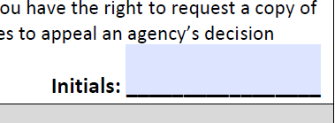
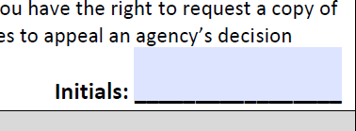
CLIENT RIGHTS & RESPONSIBILIES
Please read (or have the client read) his/her Rights and Responsibilities.
Have client initial that he/she has read and understands their rights and responsibilities, but only after he/she has acknowledged that they fully understand these rights and responsibilities and their questions and concerns have been answered.

Slide 80
Process
Case Manager will read or have the client read the above statement and go through the list of current providers.
(fill in the name of his physician
(Optional) the client can fill in the name of his partner/spouse/other (this would be preferably his emergency contact)
ROI
Case Manager will read or have the client read the above statement and go through the list of current providers.
The client can fill in the name of his physician
The client can fill in the name of his partner/spouse/other (this would be preferably his emergency contact)
The client cannot choose which agencies he wishes to place on this list, and which to remove. If the question arises, assure the client that ONLY those agencies who he/she has sought services from will have access to their information.

Slide 81
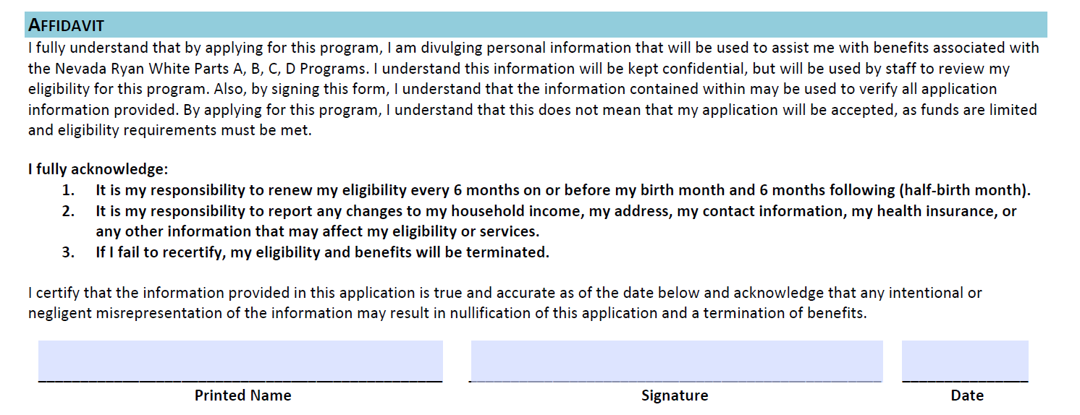

Slide 82
Recertification
Clients must reassess their eligibility status every six months, upon either their birthday or ½ birthday or sooner if their circumstances have changed. This reassessment provides an opportunity to review and update a client’s eligibility, progress, consider successes and barriers, and evaluate the previous period of activities. The recertification process may be completed in person, by mail, phone, or other electronic means. If a client has not recertified prior to the expiration of their current benefits, they may be dropped from all elements of the Ryan White program.
Annual Review
Case Managers must conduct a comprehensive annual eligibility assessment during the clients birthday month to determine the ability to continue access to Ryan White services. Clients must have a completed Universal Application 18-05 and verified required documentation prior to the finalization of the process.
6-Month Attestation
Case Managers must conduct an eligibility assessment during the clients ½ birthday month to determine the ability to continue access to Ryan White services. Clients must have a completed Universal Application 18-06 and verified required documentation (if applicable) prior to the finalization of the process.

Slide 83
Required Documentation
Requirement | Initial | 6-Month Self Attestation | Annual Review
HIV Diagnosis | Documentation required for Initial Determination | Not Applicable | Not Applicable
Household Income (under 400% of Federal Poverty Level) | Documentation required for Initial Determination | Self-attestation of no change. Documentation required if there are changes. | Documentation required for Annual Recertification Determination
Proof of Nevada Residency | Documentation required for Initial Determination | Self-attestation of no change. Documentation required if there are changes. | Documentation required for Annual Recertification Determination
Insurance Status | Documentation required for Initial Determination | Self-attestation of no change. Documentation required if there are changes. | Documentation Verifying client is enrolled with an insurance.

Slide 84
Additional Forms | Description | When to use
Request for Proof of Diagnosis (CGD 15-39) | Completed by client’s medical provider who has direct knowledge of client’s HIV diagnosis. | Utilized when a client has no medical diagnosis available and needs verification of HIV Status. This form will only be utilized at initial determination.
Dependent Support Form (CGD 15-48) | Completed by an individual who is providing the client with support and/or housing status. | Utilized when a client is receiving support from a non-governmental third party. Utilized when a client has made a declaration of no income.
Verification of Residence (CGD 15-50) | Completed by client’s landlord to establish his/her physical address for residency purposes. | When a client has a residency, but has no other back-up documentation. Utilized to establish residency for eligibility purposes.
Profit and Loss Statement for Self-Employment (CGD 16-04) | Completed by a client who is self-employed or has other non-traditional income. | Utilized when client’s income is from a self-owned business (including proprietorships and partnerships), a paid professional, paraprofessional, or occupational services (such as lawn care, domestic work, handyperson, landscaping, salesperson, street entertainer, or sex workers, etc.) Utilized to establish income.
Dental Insurance Enrollment Form (CGD 19-08) | Completed by Client who lacks standalone dental insurance or in need of cost-sharing assistance. | Completed during initial eligibility and every six months (during recertification)
ADDITIONAL PAPERWORK
The following are optional forms to be completed with the specific purpose of determining client’s initial and/or continued eligibility.

Slide 85
Dental Insurance
Eligibility Specialists will fill out the Dental Insurance Enrollment Form as part of the Universal Eligibility packet for those clients enrolling in dental coverage.

Slide 86
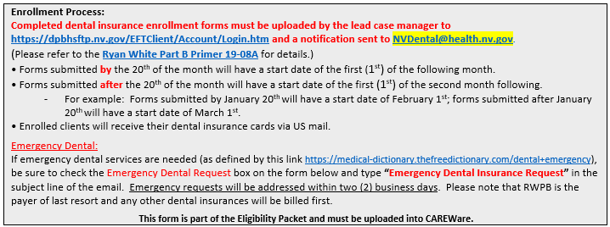
Liberty Dental Enrollment Form
20th and before start the first of the next month
Application Date – 20th June
Eligibility Start Date – 1st July
21st and BEYOND start the first of the month after the next
Application Date – 21st June
Eligibility Start Date – 1st August
Emergency Request start the 1st of the current month.
Application date - 13th June
Eligibility Start Date – 1st June

Slide 87
Liberty Dental Enrollment Form
5/8/2022
11/31/2022
MO Thompson
702-486-0872
6/1/2022
11/31/2022
Ryan White Eligibility Dates – Dates from RW Eligibility Document
Start Date: Date document completed (8th May 2022)
End Date: Last day of appropriate month (30th November 2022)
Liberty Dental Eligibility Dates
Start Date: ALWAYS Use LD Eligibility Information
If client applies for LD at the same time as Ryan White (1st June 2022)
If client comes in a later date requesting LD
Use LD Eligibility Information
End Date: ALWAYS Match With RWPB Eligibility End Date

Slide 88
Liberty Dental Enrollment Form
Balboa
Rocky
Male
RCBL08171U
08/17/1999
567-555-8521
x
301 Cobblestone Way
Henderson
NV
89127
Client General information shall mimic RWHAP (and CAREWare)
Emergency Request only if the client request it
Mailing address only needed in different from Home address
SSN or TIN category will be used for verification of other health benefits. This category may be left open if the client does not have an SSN or TIN.

Slide 89
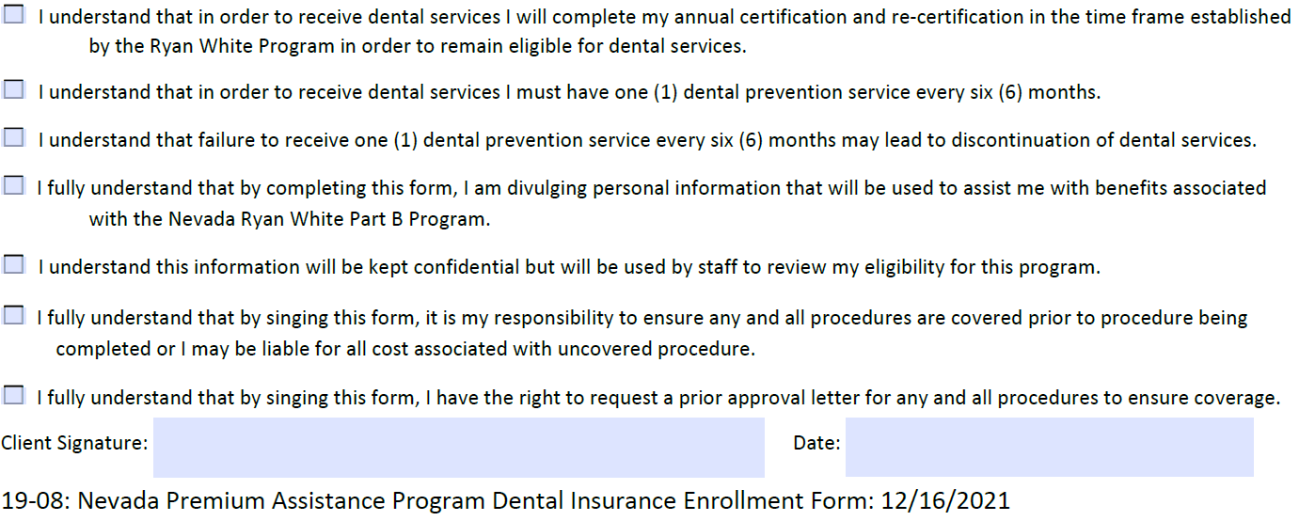
Liberty Dental Enrollment Form
The client must read the form, check the boxes and sign the form.
Ensure clients fully understand their dental insurance (i.e., approved procedures and eligibility dates)
Liberty Dental costumer care number (all clients should have) 888 - 401-1128.

Slide 90
Liberty Dental Users
Ryan White Part A
CCC
Yendi Webster
Rosa Loaiza
NARES
Cynthia Watson
Nye County
Anita Lockhart
COMC
Josefa Ozaeta
Mariana Rivera-Gonzalez
UMC Wellness
Regina Brown
Ruth Gomez
Horizon Ridge
AHF

Slide 91
Liberty Dental Users
Ryan White Part B
ACCEPT
Michelle Pavia
Gwen Taylor
HOPES
Oscar Segura Saldana
Andres Sanchez

Slide 92
Liberty Dental Users
Ryan White Part A/B
AHN
April Sanchez
Fabiola Tannahill
AFAN
Karina Ponce
SNHD
Laurie Langdok
Adriana Rubio Lerma

Slide 93
Liberty Dental New Client
Start enrollment process.
Client that has never been RWPB Liberty Dental.
Summary of Benefits – These are benefits offered by Liberty Dental.

Slide 94
Liberty Dental New Client
Tier – Employee only
Member Number – uncheck auto-assign and use Ryan White URN
Relationship – Self
Effective Date – Liberty Dental current plan Effective Date
Expiration Date - Ryan White Eligibility End Date

Slide 95
Liberty Dental New Client
First Name – Legal First Name
Last Name – Legal Last Name
Gender – Client identifies

Slide 96
Liberty Dental New Client
Address 1 - Address where client receives mail.
City – City where client receives mail.
State - Where client receives mail.
Zip – Zip code where client receives mail.
Enroll – Enroll client in Liberty Dental insurance plan.

Slide 97
How To Find Clients
SSN# - Do not use
Subscriber – Use Ryan White URN
AS of Date – (can be left blank) Uses that date to search for active plans as of that date.
Last Name - Search by Last Name

Slide 98
Updating Dental Coverage Dates
RCBL08171U
Balboa
Rocky
08/17/1999
RCBL08171U
Balboa
Rocky
08/17/1999
View – Select to update client details.

Slide 99
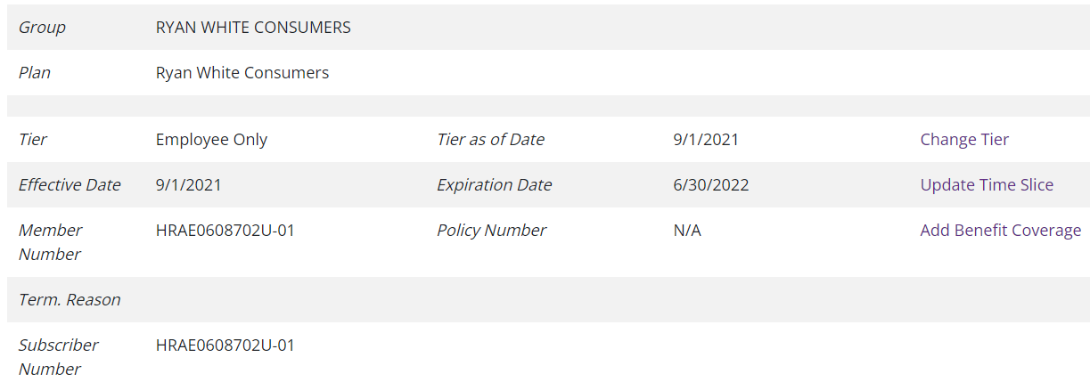
Updating Dental Coverage Dates
5/1/2021
5/1/2021
8/31/2022
RCBL08171U
RCBL08171U
Change Tier – Not used
Update Time Slice – Updating current clients whose eligibility has not expired (six-month eligibility or annual certification)
Add Benefit Coverage – For clients who have fallen out of care and are returning

Slide 100
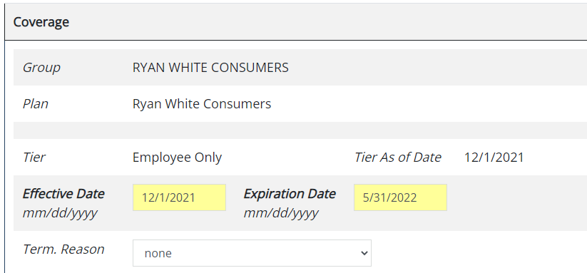
Updating Time Slice
5/1/2021
Effective Date – Date original current plan started (DO NOT CHANGE)
Expiration Date – New Expiration date from Ryan White plan.
Save

Slide 101
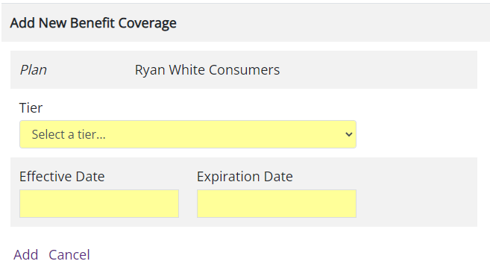
Add New Benefit Coverage
For clients who have fallen out of care and are returning.
Tier – Employee only.
Effective Date – New Liberty Dental Effective Date.
Expiration Date – Ryan White Expire Date.
Save

Slide 103
Ryan White Contact Information
PART A
PART B
TIFFANY EVANS
Email: tiffany.evans@clarkcountynv.gov
P: (702) 455-3433
TONY GARCIA
Juan.Garcia@clarkcountynv.gov
P: (702) 455-7255
MARQUES THOMPSON
Email: mthompson@health.nv.gov
P: (702) 486-0872
SARAH COWAN
Email: Scowan@health.nv.gov
P: (702) 486-0768

Slide 104
PROGRAM QUESTIONS: Part B
CAREWare Related CAREWareHelp@helath.nv.gov
Liberty Dental NVDental@health.nv.gov
RWPB & NMAP Programmatic Issues NVRWPB@health.nv.gov
RWPB, NMAP & HOPWA Fiscal Issues NVRWFiscal@health.nv.gov
RWPB & NMAP Quality Management NVCQM@health.nv.gov
HOPWA Programmatic Issues NVHOPWA@health.nv.gov
PROGRAM QUESTIONS: Part A
CAREWare/RWISE Issues rwsupport@triyoung.com

Slide 105
For Further Information
Las Vegas TGA https://lasvegastga.com
End HIV Nevada https://endhivnevada.org
HRSA https://www.hrsa.gov
Universal Eligibility Manual
Dental Insurance Forms
2022 Poverty Guidelines
https://aspe.hhs.gov/topics/poverty-economic-mobility/poverty-guidelines

Slide 106
Have a Good Day

